Slide 1
Python Training and q&a
Session 1 – August 8, 2017

Slide 2
What is python?
Python is a computer programming language first implemented in 1989 and first publicly released in 1991 by Guido Van Rossum
Designed as a successor to the ABC programming language
It is an interpreted, dynamically typed, multi-paradigm programming language
Built around and influenced by several key design principle now called “The Zen of Python”. An excerpt:
Beautiful is better than ugly.
Explicit is better than implicit.
Simple is better than complex.
Complex is better than complicated.
Fun fact: Named after Monty Python’s Flying Circus since van Rossum was a big fan of the show

Slide 3
advantages/disadvantages of python
Advantages
Code is relatively easy to learn, read, and write
Huge standard library (can do out-of-the-box development for most applications easily)
Also a huge open-source community for designing third-party packages
Good support for reusable mechanisms like objects, functions, etc.
Data structures in Python are user-friendly and don’t require much support code
Disadvantages
Code will be slower than Java, C++, or other compiled languages due to extra work done by interpreter at runtime
Dynamic Typing means more testing is required on code
Global Interpreter Lock (GIL) prevents use of multiple threads when running a program which limits amount of parallel processing that can be done
Because Python relies on indentions to separate code blocks, you can’t code freeform style. Spacing and indention matter here!

Slide 4
What can we use python for?
Scientific Computing and Data Science via SciPy stack
Web Development via frameworks like Django, Flask, and Tornado
Web Scraping and interacting with APIs
Programming and Computer Science Education
“Glue” language in software engineering projects to combine code written in other languages
Other uses include…
Hacking and penetration testing
Automated Testing
Game Development
And many more!

Slide 5
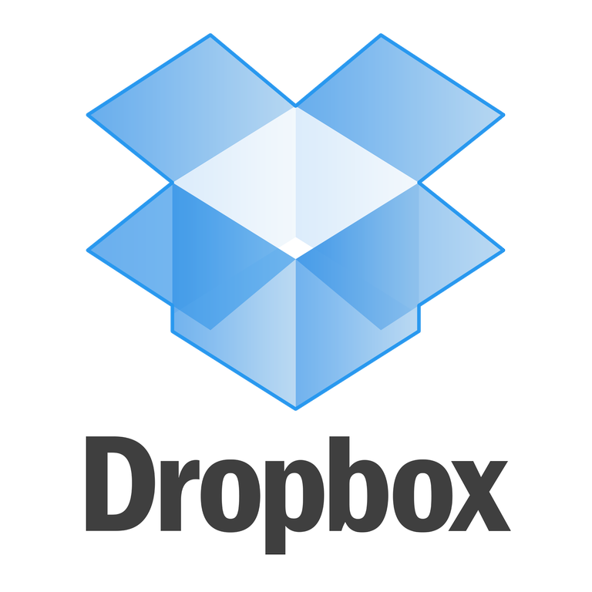
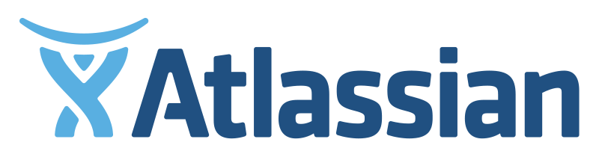

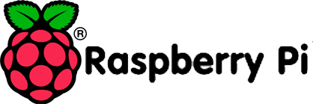



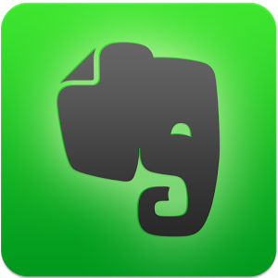
Who else uses python?

